Slide 1

ten_products_boughts = {k: v[:100] for k, v in customerA_dictionary.items()}
def showProductsBoughts(productList):
numberProducts = len(productList)
plt.figure(figsize=(10, 20)) # set figure size
rows = 10 # number of subplot rows
cols = 5 # number of subplot columns
for i in range(rows * cols):
if i >= numberProducts:
break
filename = getFilename(productList[i])
if not exists(filename):
print("File '" + filename + "' does not exist")
continue
image = cv2.imread(filename)[:,:,::-1]
plt.subplot(rows, cols, i+1)
plt.title(productList[i], size=10)
plt.imshow(image)
plt.axis('off') # turn off axis numbers
plt.tight_layout() # adjust subplot spacing
plt.show()
return
customer= customerA
customerProducts = ten_products_boughts.get(customer)
showProductsBoughts(customerProducts)
Better Together
A SIMPLE Fashion Recommender
Presented by your Nomadic Process

Slide 2
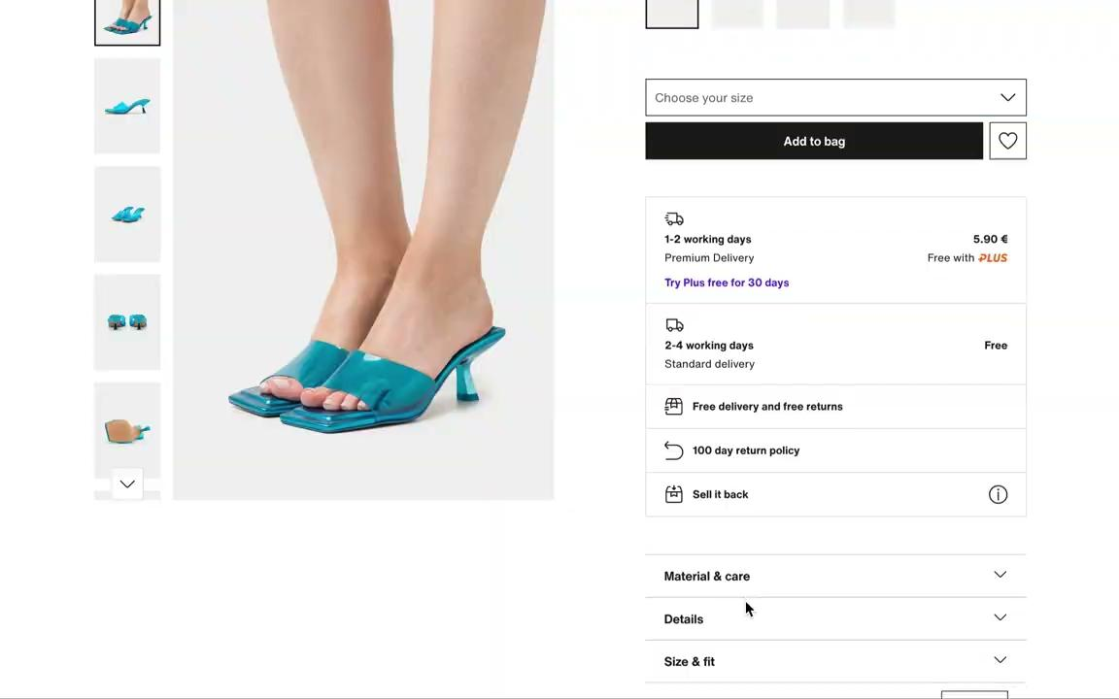
RECOMMENDATION SYSTEM IS EVERYWHERE
ON FASHION E-COMMERCE SITES
www.slidescarnival.com

Slide 3
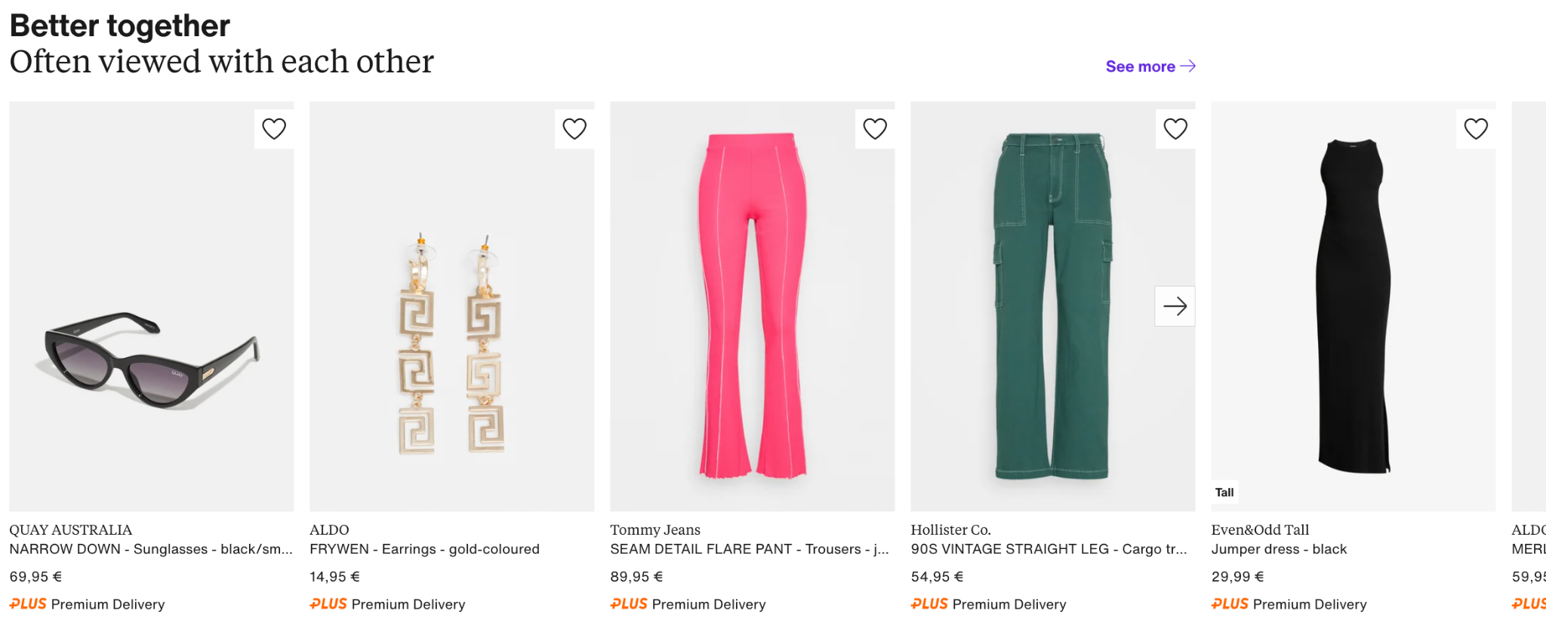
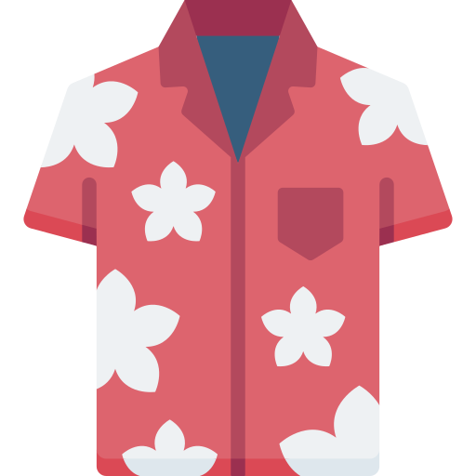



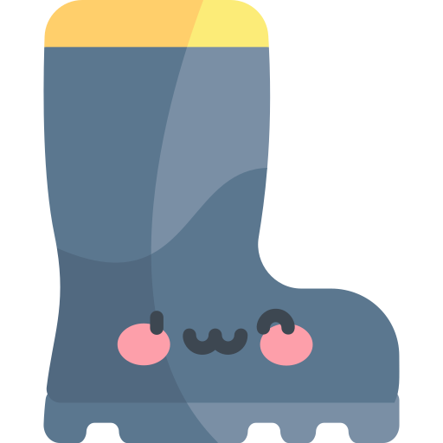

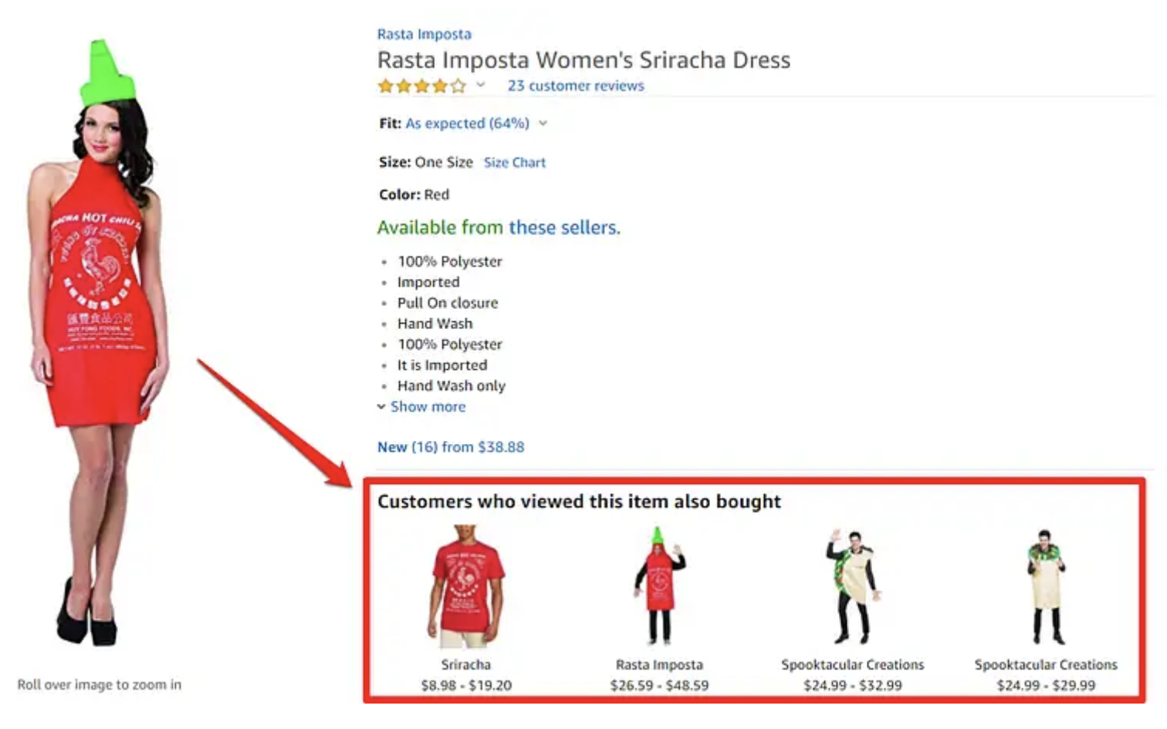


A SIMPLE YET POWERFUL IDEA..
..…
Pairing them together
?
BASED ON WHAT OTHER HAVE BOUGHT TOGETHER

Slide 4
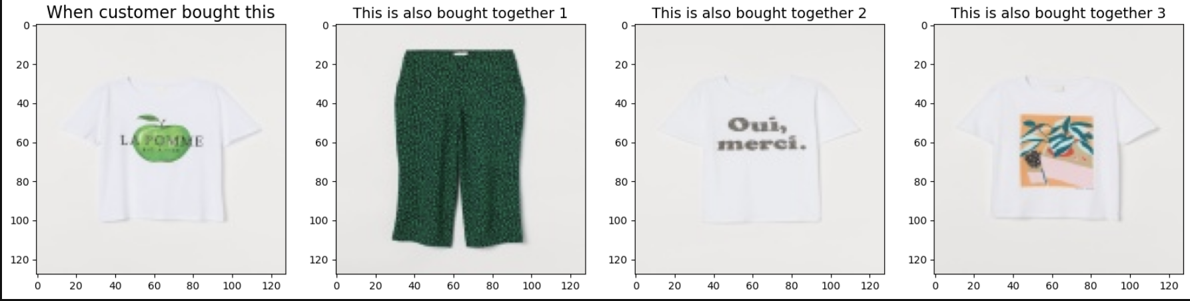
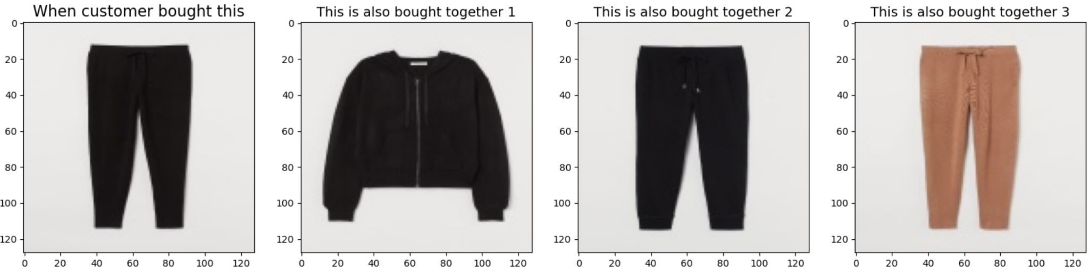
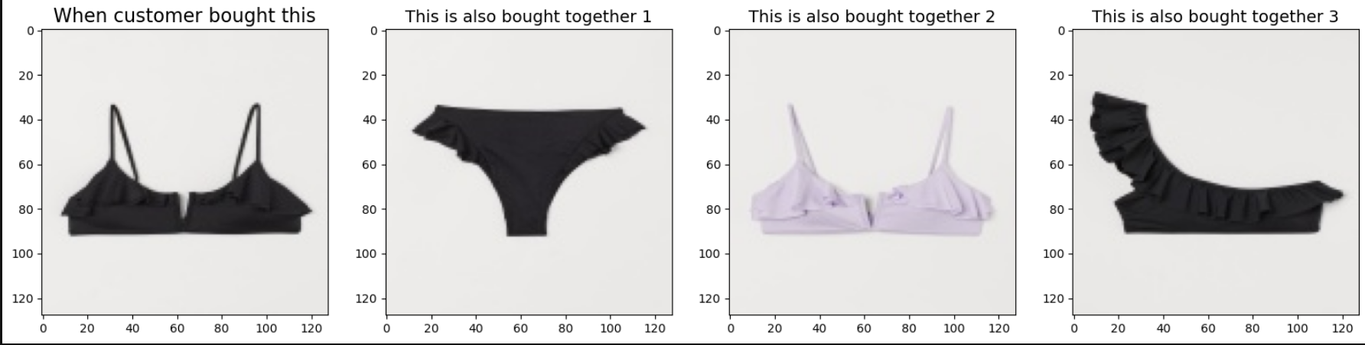
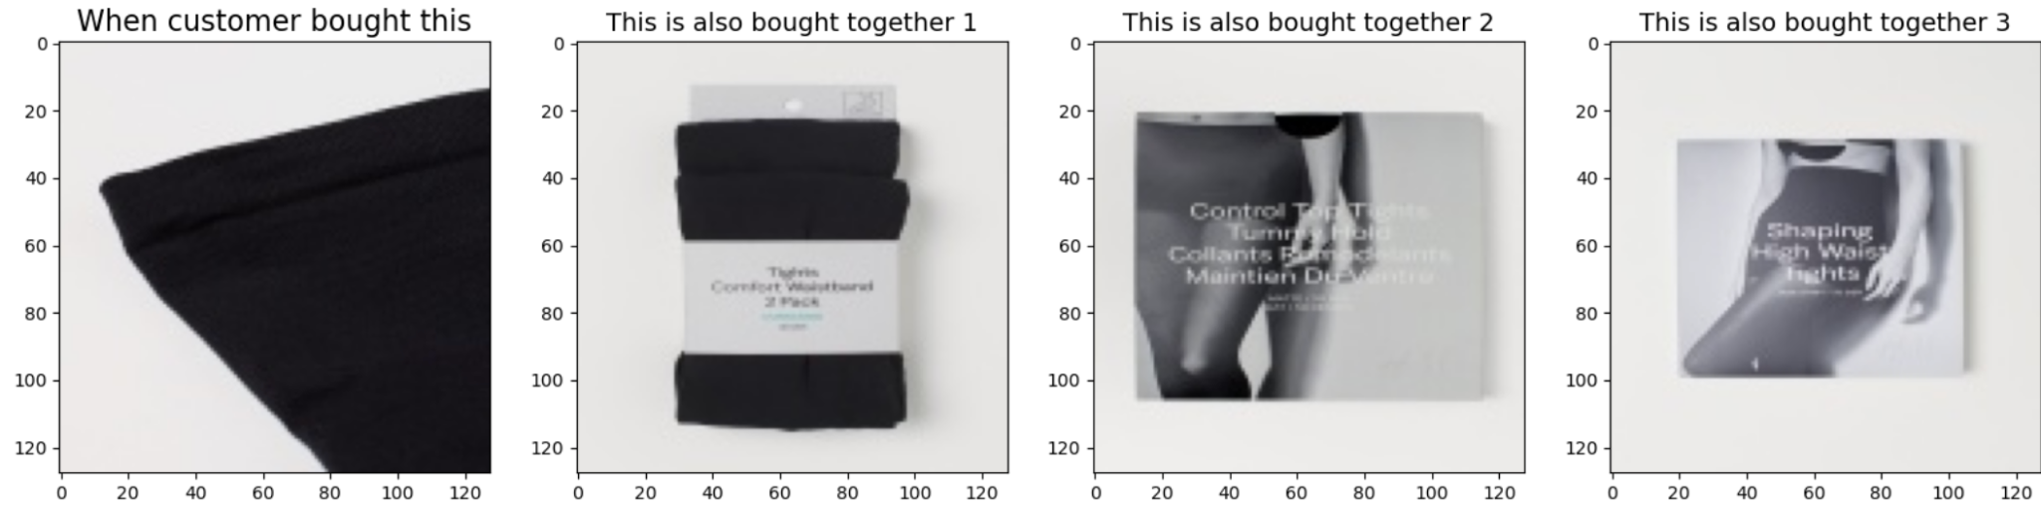
Outcome of Pairing Deck
When customer bought this, they also bought that, that and that…
and we created a collection of key-value to stored this kind of frequencies..

Slide 5
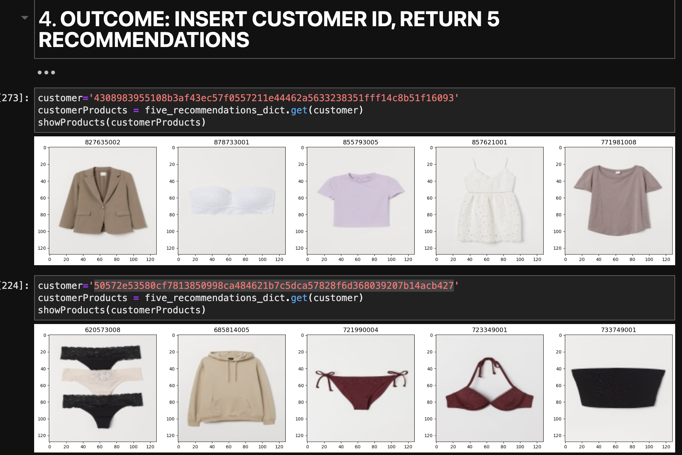
Outcome of Current Model
Insert the Customer ID,
Return 5 Product Recommendations

Slide 6


Let’s Explore some Recommended Results..

Slide 7
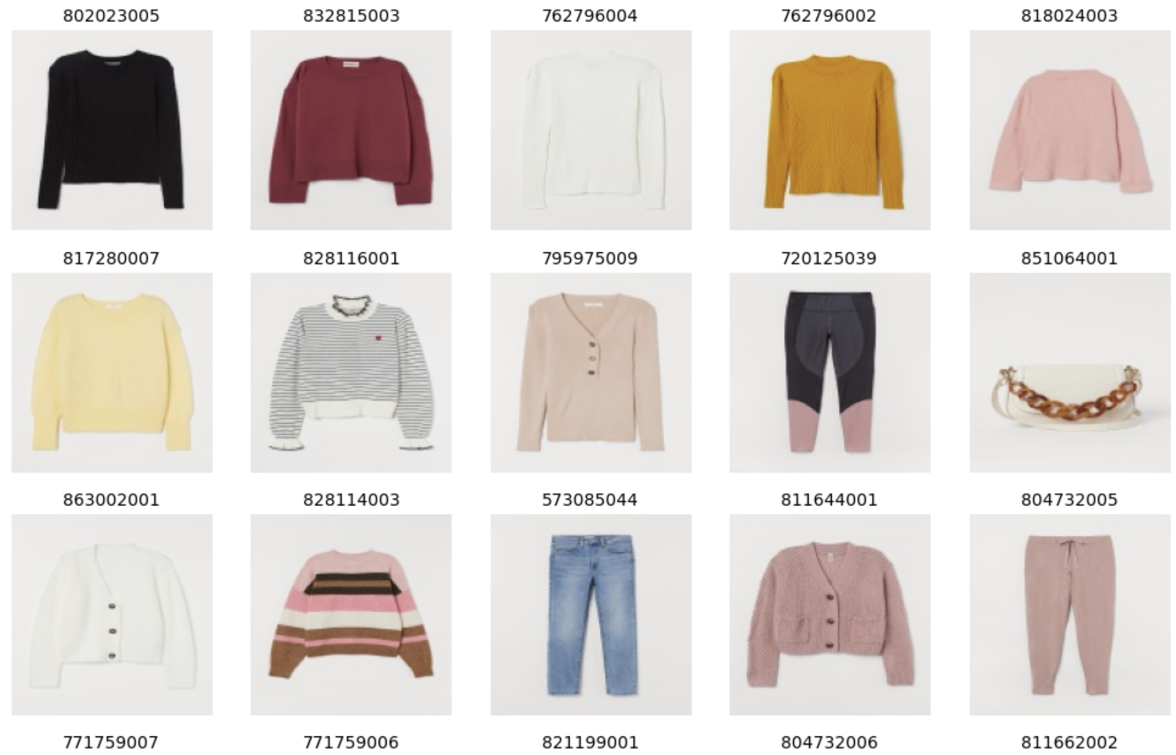
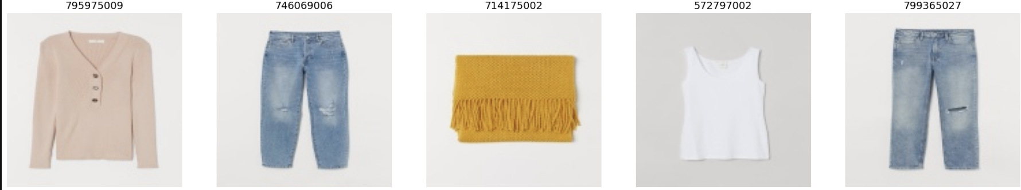
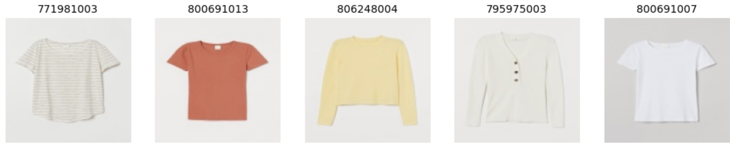
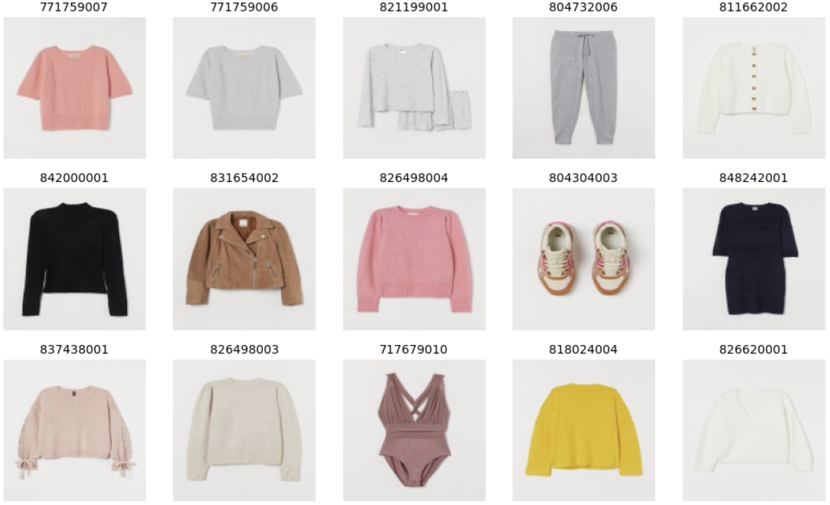
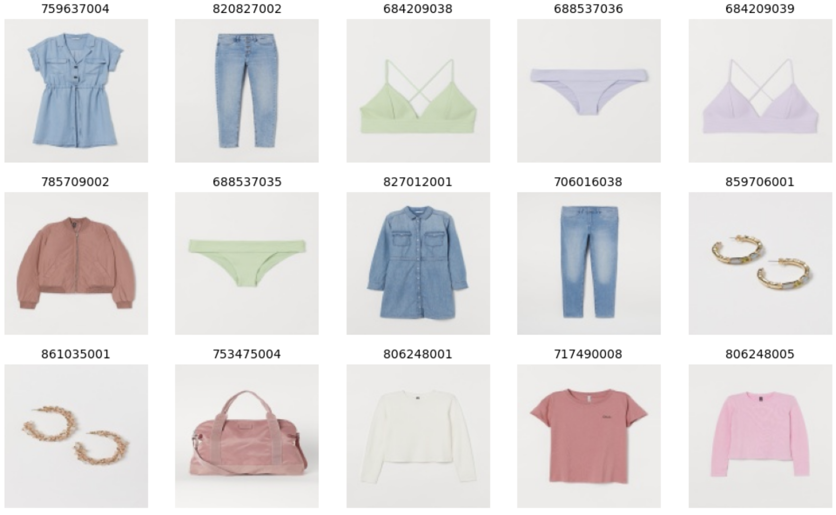
Customer A -
Pastel Lover
WHAT DO WE RECOMMEND
WHAT SHE BOUGHT BEFORE
Profile :
- 33 years old
- Bought > 500 products
- Pastel lover; denim; comfy

Slide 8
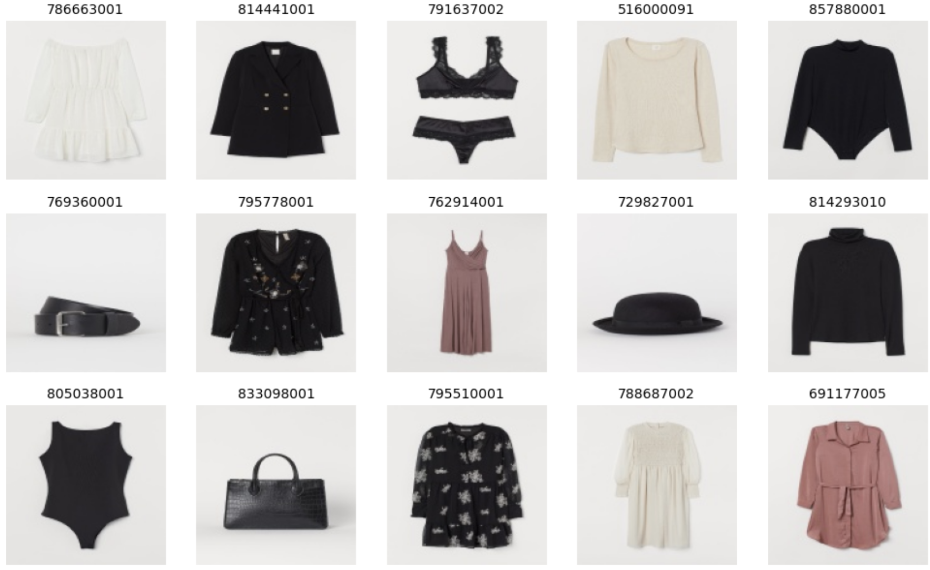
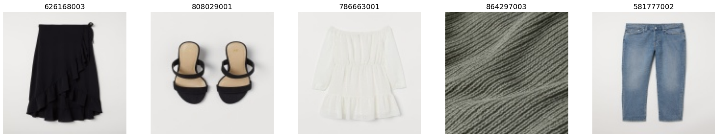
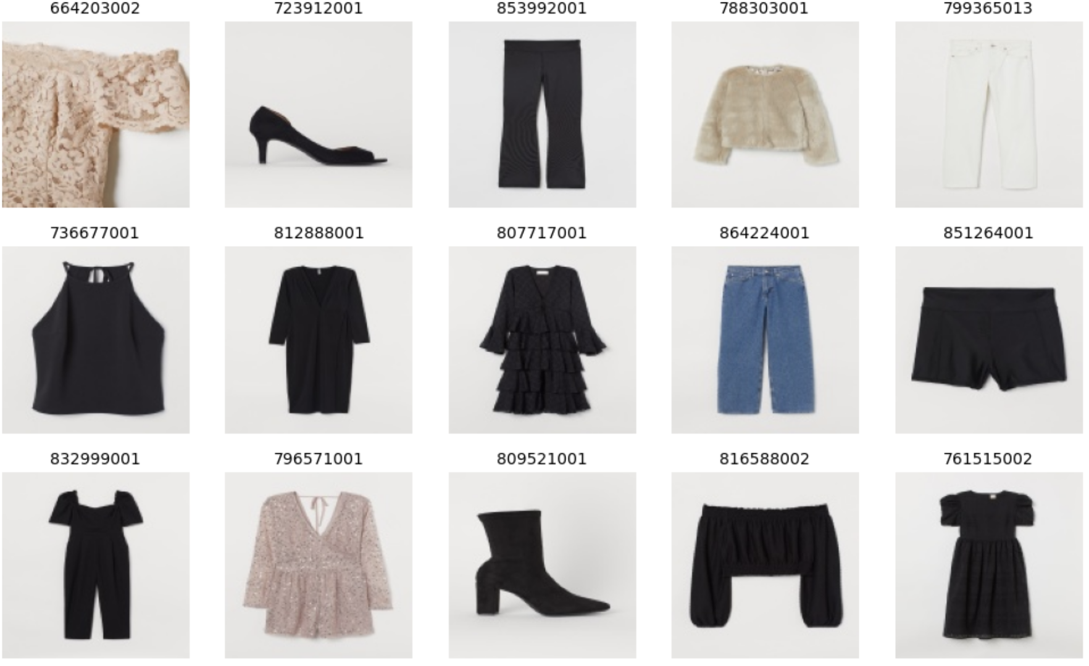
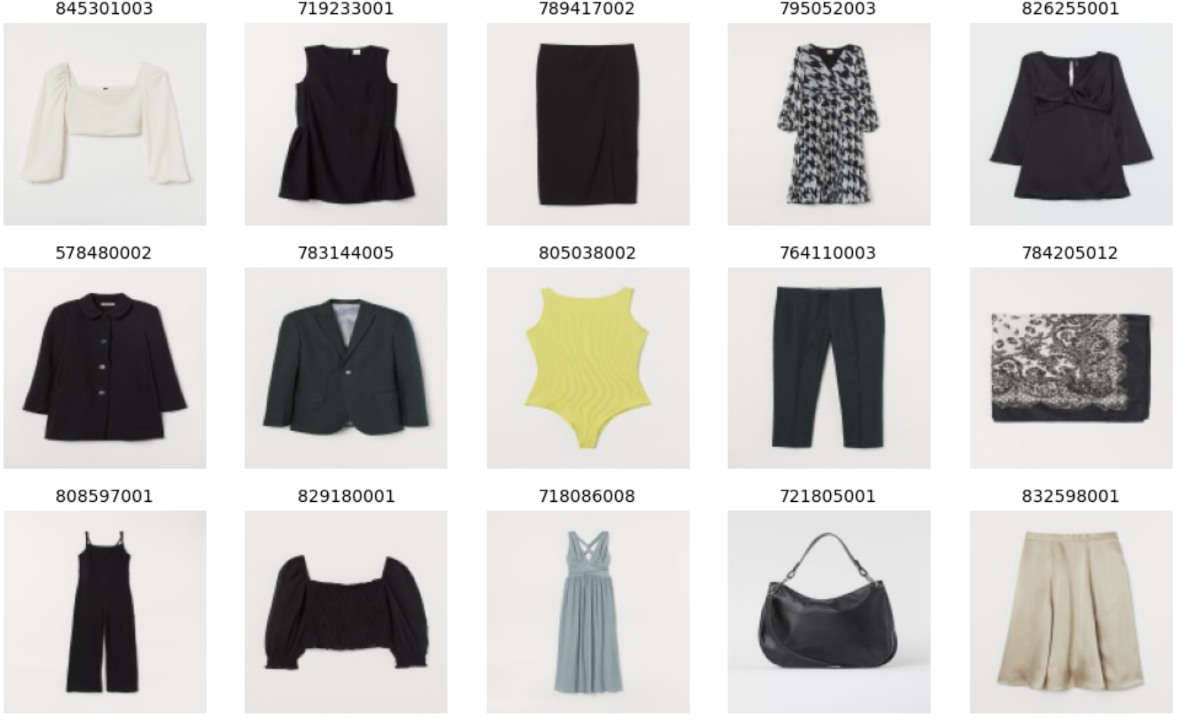
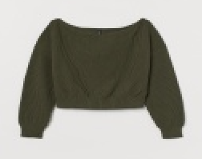
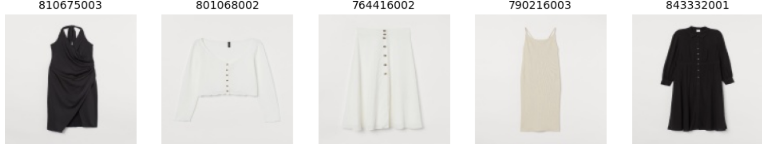
Customer B -
Fashionable Granny
WHAT DO WE RECOMMEND
WHAT SHE BOUGHT BEFORE
Profile :
- 61 years old
- Bought > 600 products
-Urban chic; White/ Black; Shoes/Accessoires

Slide 9

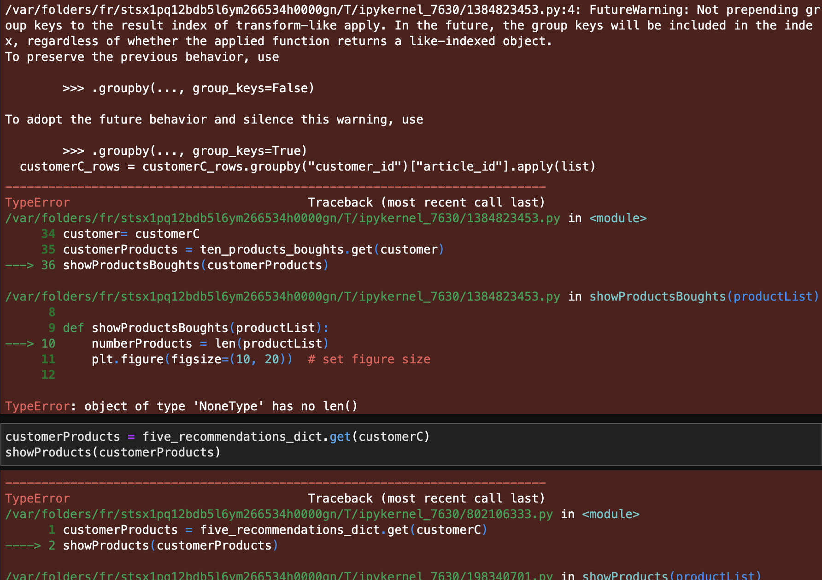
Customer C -
A typical Cold Start Problem
Profile :
- 16 years old
- no purchase data
- so this recommendation would not work
>> solution >>
hybrid approaches that combine different recommendation techniques. e.g. recommend the most popular items of this week

Slide 10



My Take-Away while Exploring in the Wonderland of (Data) Engineering
Cut Big Task/Code into Several Small Chunks.. Structure first. Don’t go straight to write the code | When I found myself doing the same thing again and again Build some (hopefully) reuseful functions. def = love | Look after Efficiency Exclude the irrelevant data in the loop or resize images did save my (machine) life
Elaborate on what you want to discuss. | Try and Error is the Way | Add a main point Elaborate on what you want to discuss.

Slide 11

Questions?
No? Thank you
Slides credit :www.slidescarnival.com

